Slide 1
Methods and function in python

Slide 2
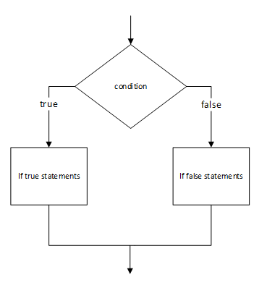
Conditional statements in Python(1/5)
The conditional statements are used to control the flow of the program depending upon the Boolean answer of the condition.

Slide 3
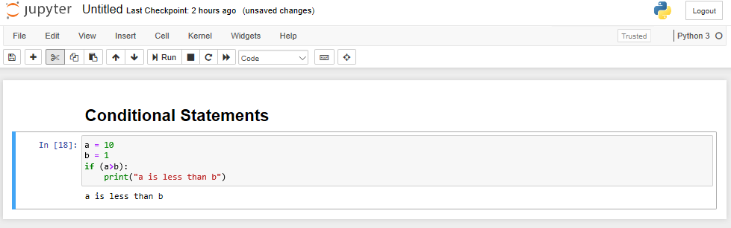
If() method(2/5)
The if() method is the most basic single condition checker.
Syntax:
If (test condition):
expression

Slide 4
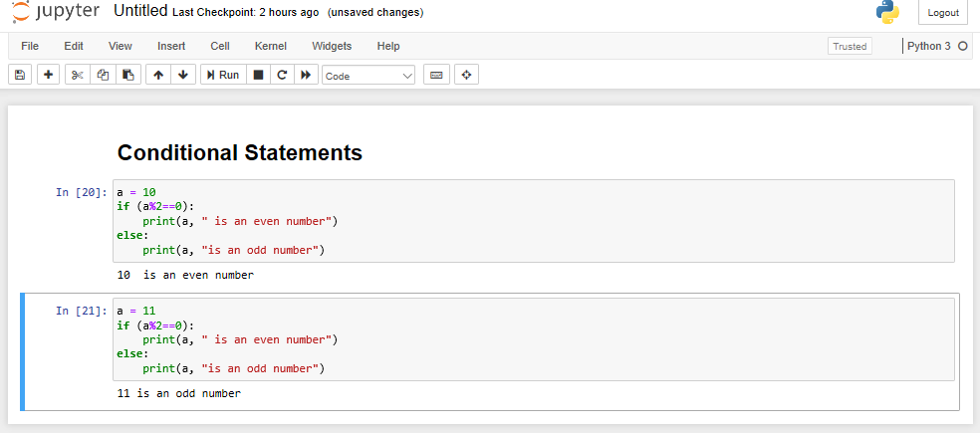
If else() method(3/5)
If else controls the flow of the program by selecting one of the two options depending upon conditions used.
Syntax:
if (test expression):
expression
else:
expression

Slide 5
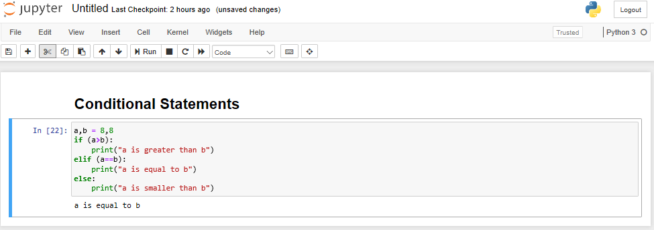
elif() method(4/5)
If the number of conditions increase more than two we tend to use the ‘ELIF()’ method.
Syntax:
if (test condition):
expression
elif (test condition):
expression
else:
expression

Slide 6
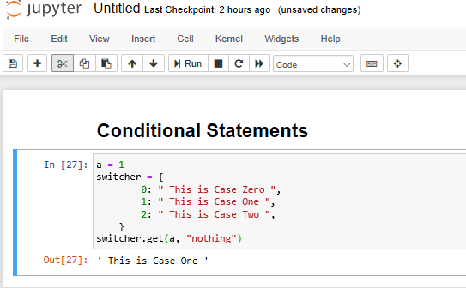
Switcher(5/5)
The switcher in python is a multi branched conditional statement.
Syntax:
switcher = {
case 1: expression,
case 2: expression,
}
switcher.get(argument, ”nothing”)

Slide 7
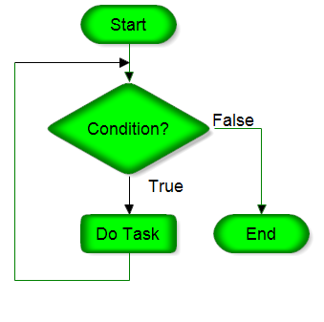
Iterative statements(1/3)
Iterative statements are also known as the looping statements or repetitive statements.
They are used to repeat a part of code repeatedly as long as the given condition is true.

Slide 8
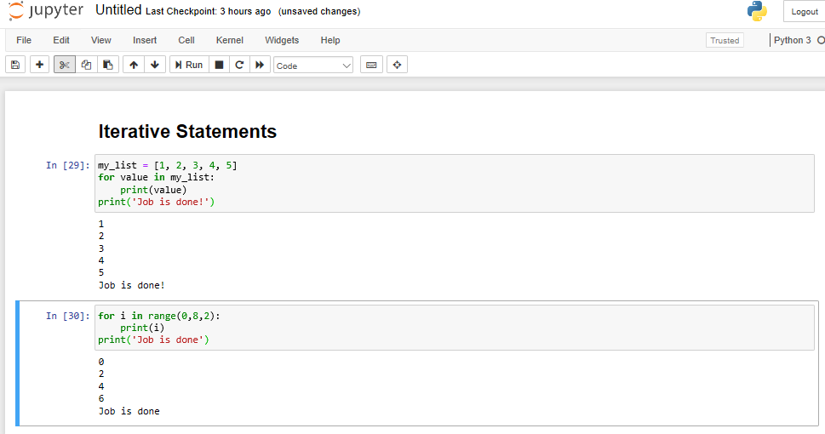
For() loop(2/3)
The for() loop in python is generally used to iterate through a sequence like a list, a tuple, a set, a dictionary, or a string.
Syntax:
for <test condition> in <sequence>:
statement
statement
statement

Slide 9
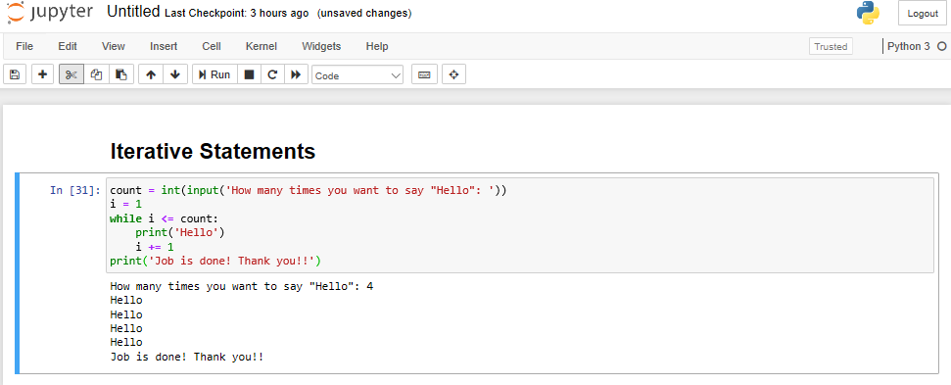
While() loop
While() loop is an entry control loop which means that the condition is checked before entering in loop and running the statements.
Syntax:
while text condition:
statement
statement

Slide 10
Functions in python(1/3)
Functions are the blocks of code which are executed only when they are called.
To create a function we use ‘def’ keyword.
def funct():
print('Gurvansh')
To call the function we writes its name followed by parenthesis.
funct()

Slide 11
Functions in python(1/3)
Functions are the blocks of code which are executed only when they are called.
To create a function we use ‘def’ keyword.
def funct():
print('Gurvansh')
To call the function we writes its name followed by parenthesis.
funct()

Slide 12
Functions in python(1/3)
Functions are the blocks of code which are executed only when they are called.
To create a function we use ‘def’ keyword.
def funct():
print('Gurvansh')
To call the function we writes its name followed by parenthesis.
funct()

Slide 13
Contd.(2/3)
We can also pass data into the functions known as arguments.
def my_function(fname):
print(fname + " Refsnes")
my_function("Emil")
Output:
Emil Refsnes

Slide 14
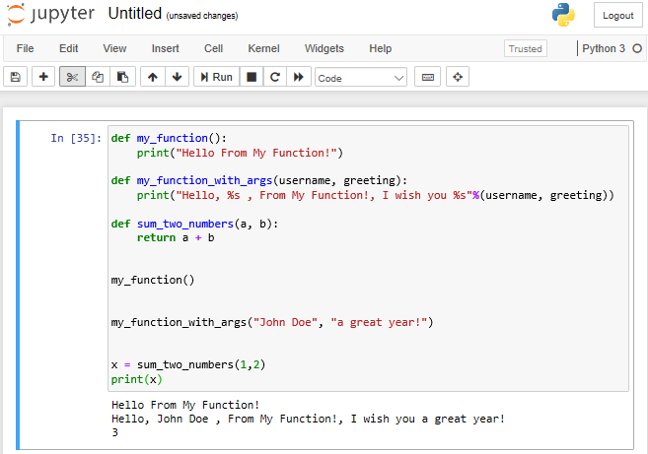
Contd.(3/3)

Slide 15
Thank you

